Slide 1


Introduction to PROMIS
Caroline Terwee
Dutch-Flemish PROMIS
Amsterdam UMC
Department of Epidemiology and Data Science
..
Notes:
In deze presentatie geef ik een korte uitleg over PROMIS.

Slide 2

What is PROMIS?
Patient-Reported Outcomes Measurement Information System
PROMIS is a system of …..
Item banks measuring generic patient-reported outcomes
Developed using Item Response Theory (IRT)…
That can be used in research and clinical practice to measure patient-reported outcomes very efficiently (using Computerized Adaptive Testing (CAT)) …
In adults and children with or without (chronic) diseases
www.healthmeasures.net/promis
www.healthmeasures.net/promis

Slide 3
Item banks
An item bank is a large set of questions (items) measuring a single construct
  Examples: physical function, depression, fatigue
  With an Item Response Theory (IRT) model the items in an item bank are ordered in terms of their “difficulty”
Notes:
30->100 items
Each item bank represents one construct (unidimensional)

Slide 4
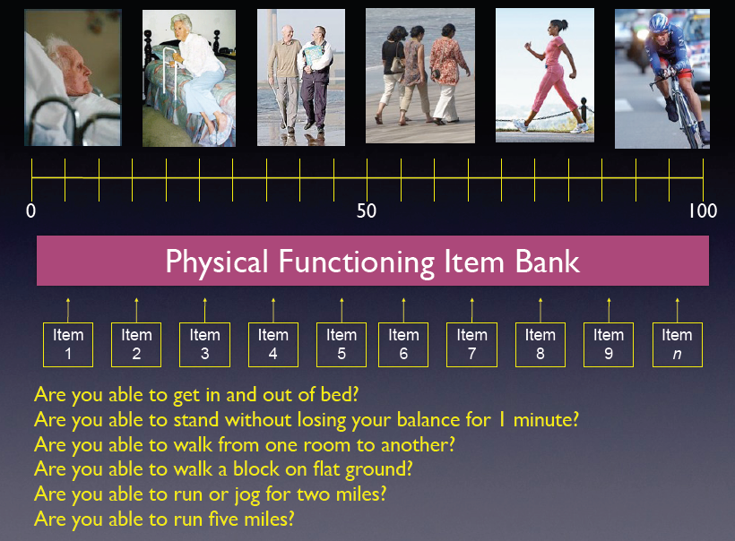
Example IRT item bank

Slide 5
Example IRT item bank
Nel
Eva
24
77

Slide 6
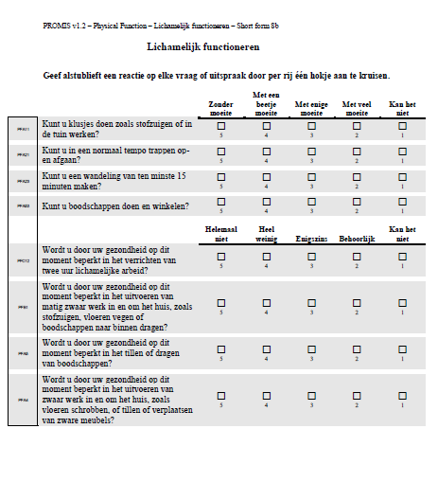
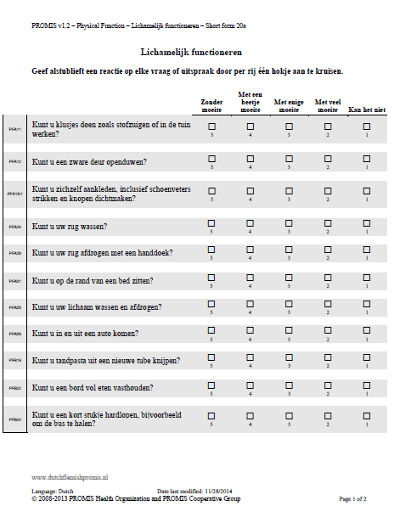
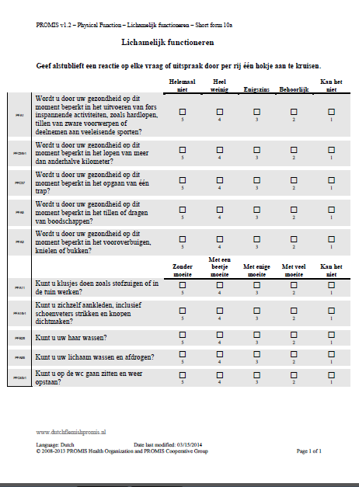
Items can be selected as short forms
Notes:
Once the item locations of all items in an item bank are determined using IRT analyses, relevant questions can be selected from the item bank for use in a specific population. For example, if you want to measure physical functioning in an elderly population you could select a set of easy items. Or, for more general purposes, you can use a representative sample of items that cover the whole scale.
These fixed selections of items are called short forms. All short forms from an item bank are scored on the same metric so scores can directly be compared even if people so not answer the same questions because we know the individual item locations on the scale.

Slide 7
Computerized Adaptive Testing (CAT)
Notes:
We can use an item bank even more smartly for computerized adaptive testing. Now we let the computer select the questions, based on our answers.
The computer starts with a question in the middle of the item bank

Slide 8
Computerized Adaptive Testing (CAT)
NO
Notes:
If the answer is no

Slide 9
Computerized Adaptive Testing (CAT)
NO
Nel
Notes:
An initital score is estimated with a confidence interval. The initial confidence interval is wide because we have asked only one question.

Slide 10

Computerized Adaptive Testing (CAT)
NO
Nel
Notes:
The computer will now select the next question that is most informative given the estimated score.

Slide 11
Computerized Adaptive Testing (CAT)
NO
YES
Nel
Notes:
Angain an answer is given..

Slide 12
Computerized Adaptive Testing (CAT)
NO
YES
Nel
Notes:
And a new score is estimated. The confidence interval is smaller now because we have more information.

Slide 13

Computerized Adaptive Testing (CAT)
NO
YES
Nel
Notes:
This process continues…

Slide 14
Computerized Adaptive Testing (CAT)
NO
YES
NO
Nel

Slide 15
Computerized Adaptive Testing (CAT)
NO
YES
NO
Nel
24
Notes:
….. until a predefined confidence interval is achieved. On average about 5 questions are needed to get a score which is as reliable as a 20-item traditional questionnaire.
This is a 75% reduction of patient burden.

Slide 16
Item banks are sustainable
25
75
Are you able to use a smartphone?
Notes:
Items can be removed or added (like this green one), the scale remains the same.

Slide 17
Linking
25
75
SF36 – PF1
SF36 – PF3
SF36 – PF5
SF36 – PF2
SF36 – PF4
SF36 – PF6
Notes:
Items can be removed or added (like this green one), the scale remains the same.

Slide 18
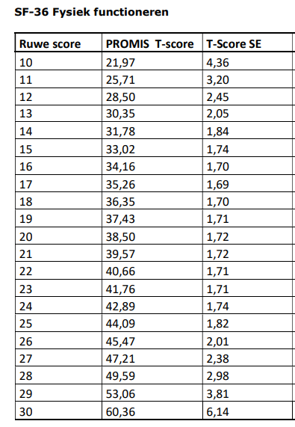
Cross-walk table
www.prosettastone.org

Slide 19
Item banks offer a metric
25
75
Metric
IRT offers a metric
The “Celsius” scale for PROs
Notes:
This means that IRT actually offers a metric for measuring health outcomes.
This is important. We have metrics for measuring other outcomes, we have the kg, meter, Celsius…. there is no metric for physical functioning or fatigue or depression. With IRT you create a metric.
PROMIS aims to offer and maintain a sustainable gold standard metric for patient-reported outcomes: the “Celsius” scale for he

Slide 20
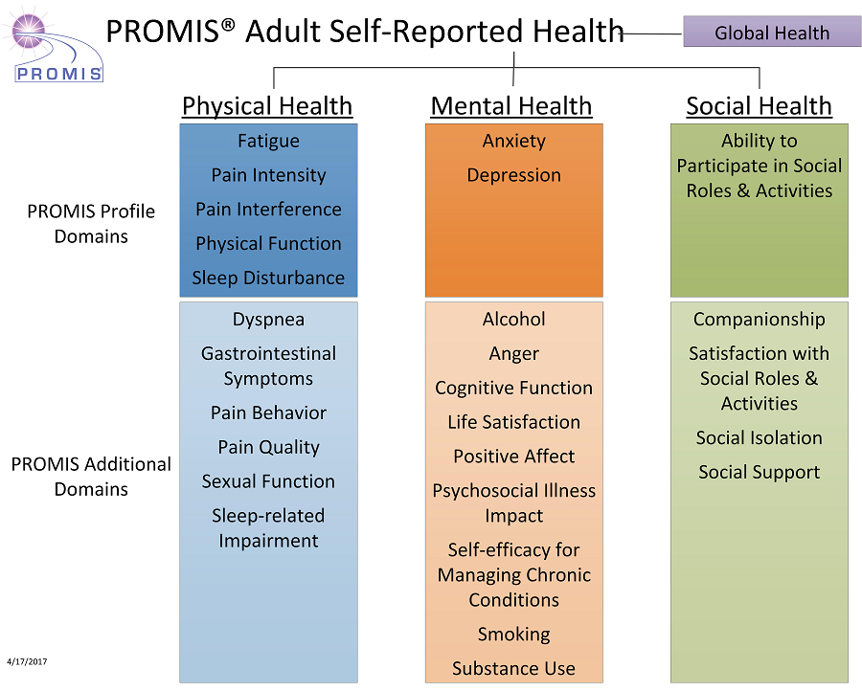
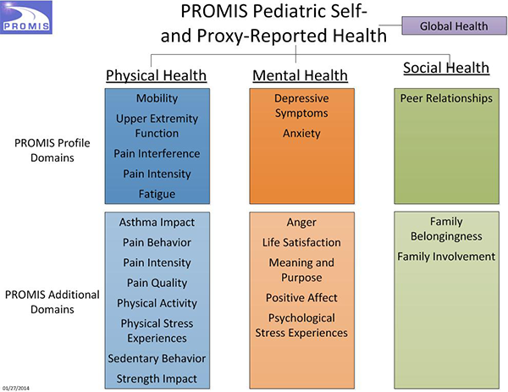
PROMIS conceptual model
  The PROMIS conceptual model includes the most relevant aspects of health for many (disease) populations

Slide 21
Interpretatie PROMIS scores
PROMIS scores are always presented as T-scores
A T-score had a mean of 50 and SD of 10 in a reference population
For PROMIS, the reference population is often the US general population
Mean scores of the Dutch general population are also available; they are often close to 50
Cut-off values for mild, moderate, and severe scores are also available

Slide 22
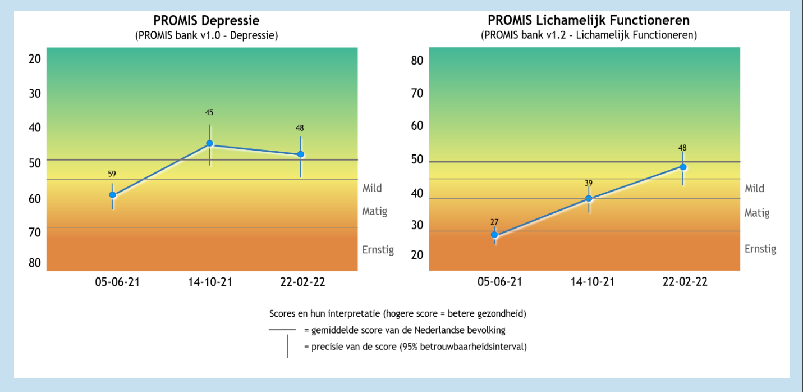
Interpretation guidelines

Slide 23
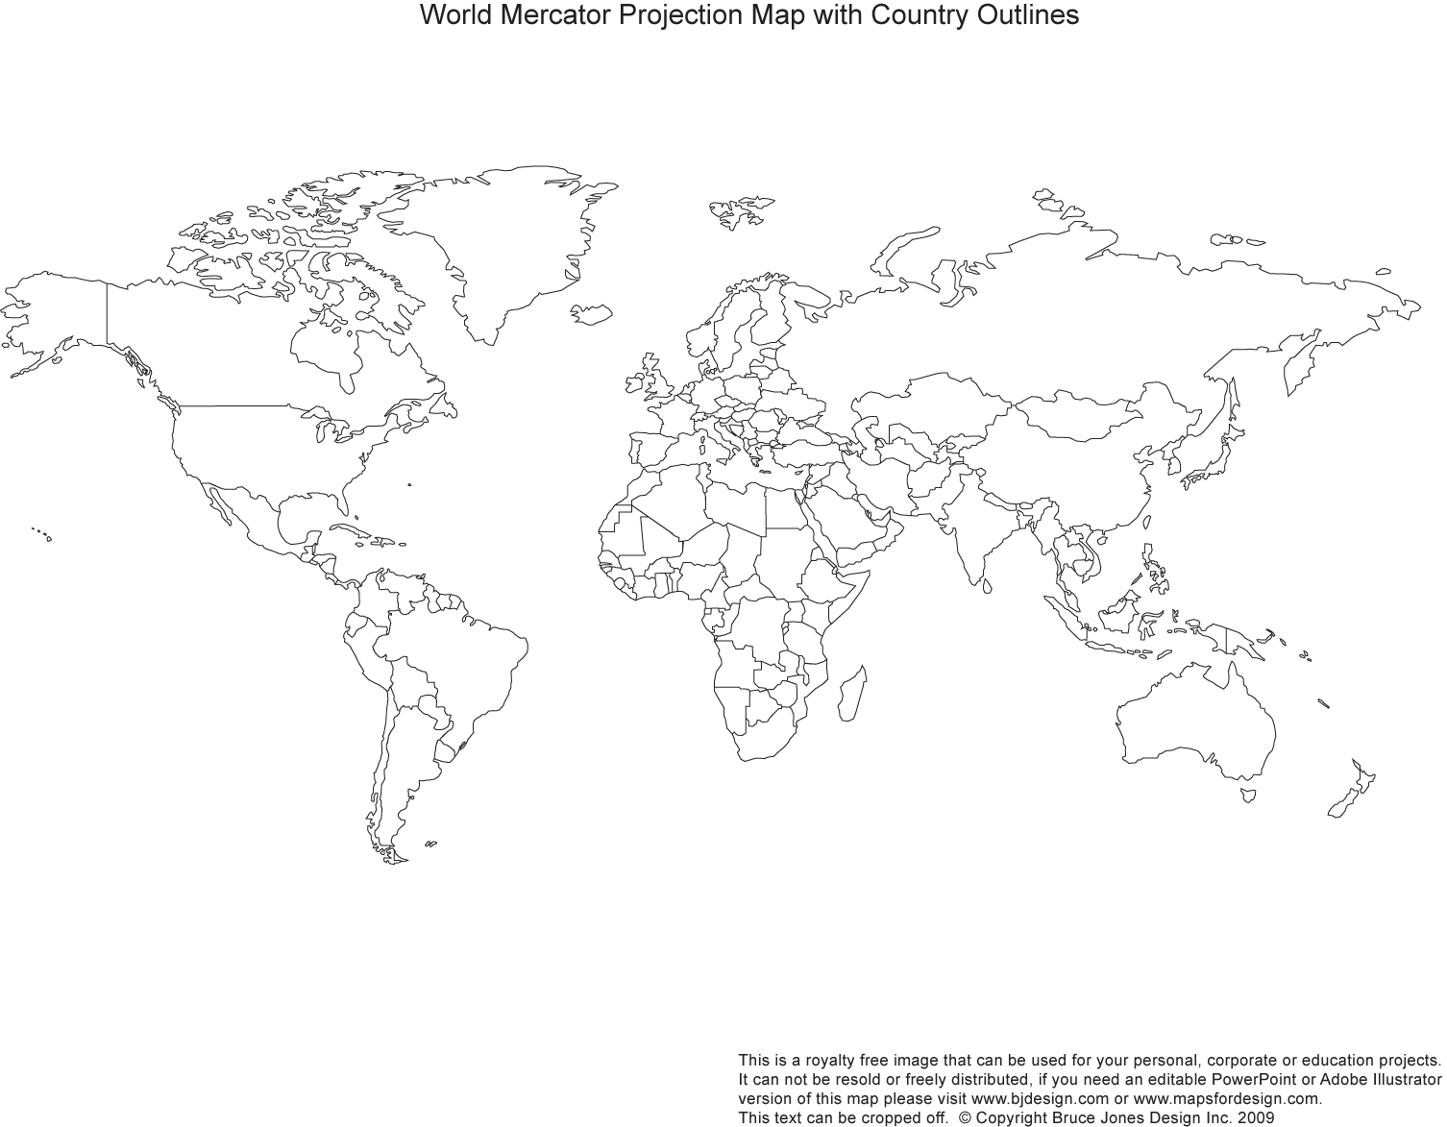
PROMIS National Centers

Slide 24

PROMIS
www.healthmeasures.net/promis
www.promishealth.org
www.dutchflemishpromis.nl

